Slide 1
Advanced Databases
Security
William Clifford
William.clifford@ncirl.ie
27/11/23

Slide 2
Overview
Specifically, we will talk about making data secure.
Why is it a concern?
List the threats to a database.
How to protect data using computer-based controls.
How to secure DBMS on the web.
Purpose and main stages of risk analysis.
Purpose of data protection and privacy laws.

Slide 3
Why is data a concern?
Data is a valuable resource
It should be controlled/managed like any other resource
Some or all corporate data may have strategic importance:
Customer information
Product information
Analytics
Security is used to protect databases against both intentional and accidental threats.
Breaches may affect other components:
Hardware
Software
People

Slide 4
Why is data a concern?
Database security is often considered in relation to:
Theft and fraud
Loss of confidentiality
Loss of privacy
Loss of integrity
Loss of availability
Aims to minimize the losses caused by anticipated events in a cost-effective manner without unduly constraining the users.

Slide 5
Threats
Any situation or event, intentional or accidental, that may adversely affect a system and consequently an organization.
Tangible threats:
Hardware
Software
Data
Intangible threats:
Reputation
Client confidence
To mitigate against threats, we:
Identify weaknesses
Test system security
Monitor access
Respond to failures effectively

Slide 6
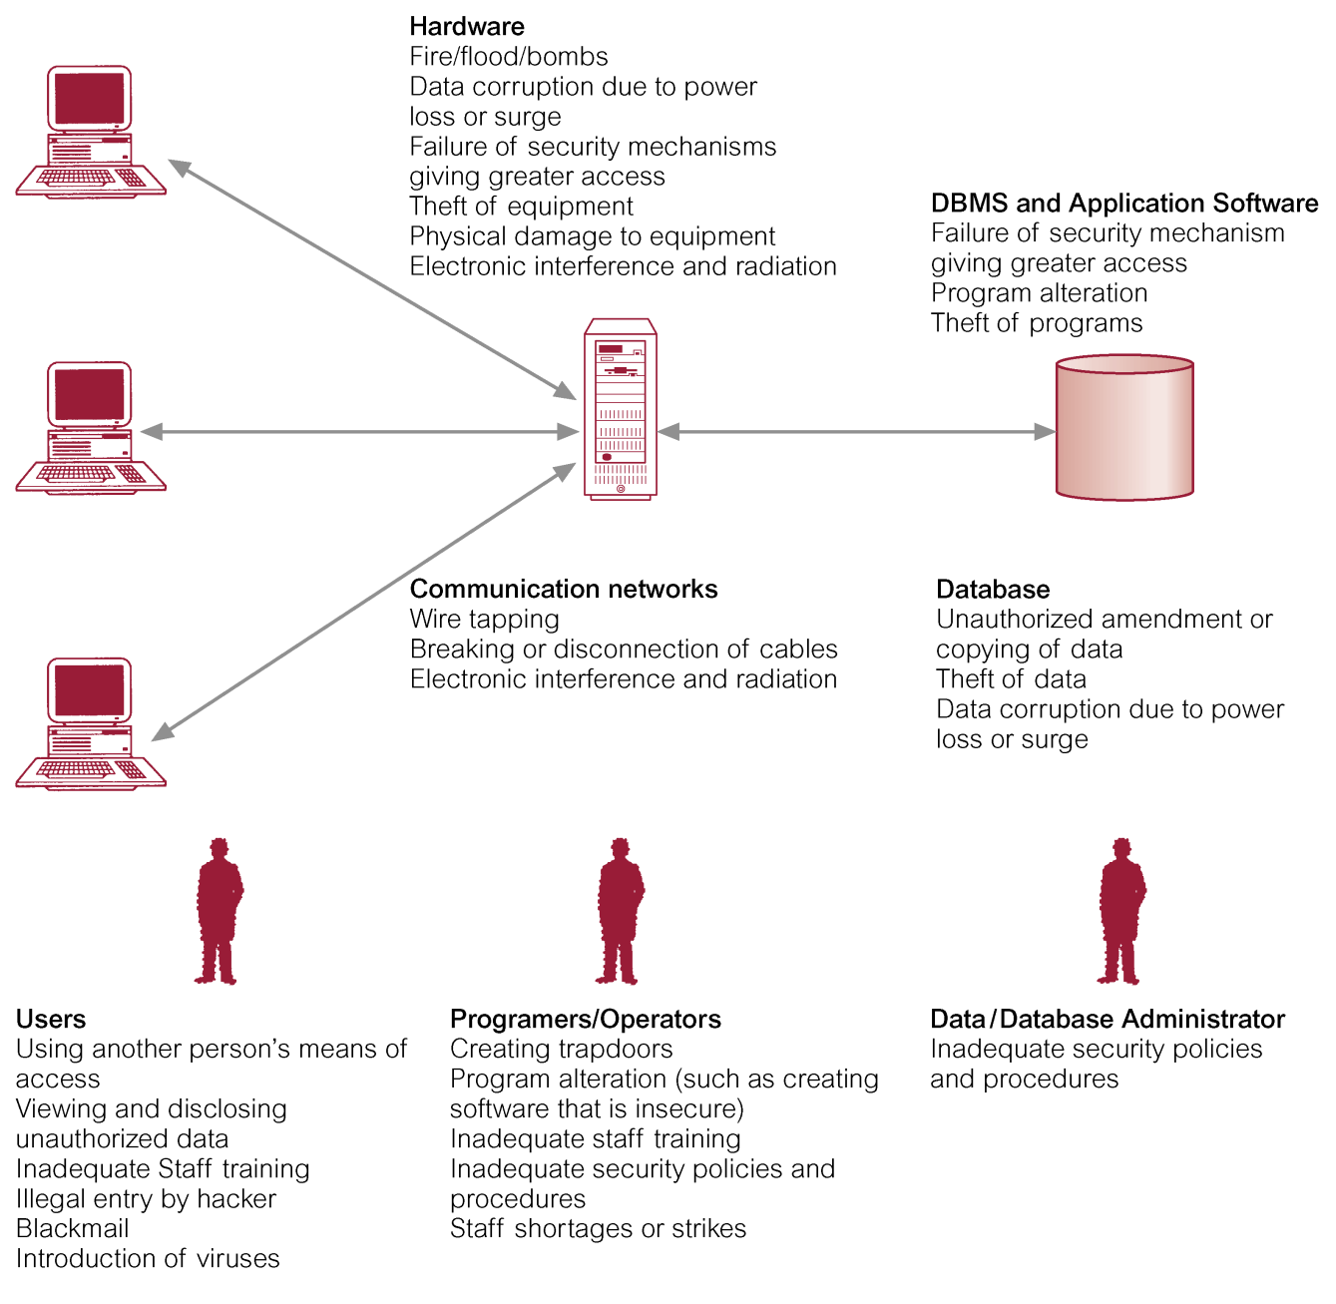
Summary of Threats

Slide 7
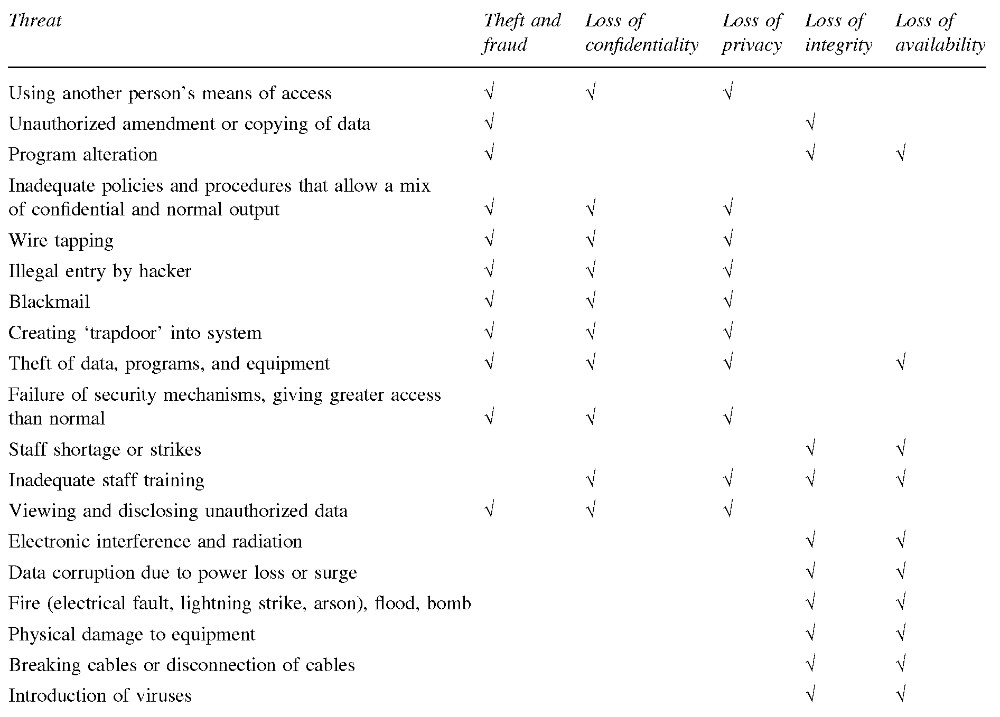

Slide 8
Countermeasures - Computer Based Controls
Can include physical control and administrative procedures.
Despite these controls the security can only be as good as the operating system it is running on.
The following countermeasures can be considered:
Authorization and Authentication
Access control
Views
Backup and recovery
Encryption
RAID technology

Slide 9

Countermeasures - Computer Based Controls
Authorization: granting of rights or privileges, which enables a subject to legitimately have access to a system or a system’s objects (database table, view).
Authentication: a mechanism that determines whether a user is who they claim to be.
Password protection
2 factor authentication

Slide 10
Countermeasures - Computer Based Controls
Access Controls:
Typically provide access controls for a database system based on granting and revoking of privileges.
Privileges allow users to create/access (read/write/modify) some database object (relation, view, or index) or run certain DBMS utilities.
Privileges are often granted to a user so they can accomplish their work.
Discretionary Access Control (DAC):
Users use GRANT and REVOKE commands for privilege allocation.
Mandatory Access Control (MAC):
System wide policies that cannot be changed by users.
Each object has a security class, and each user has a clearance.
Notes:
DAC weakness: unauthorized users can trick authorized users into providing sensitive data. Given an unauthorized user (assistant), they can create a relation to capture new client details and give access privileges to a higher up (manager) without their knowledge. The assistant can then alter application programs that the manager uses to include hidden instructions to copy sensitive data from the client relation, into a new relation created by the assistant.
MAC: can contain multiple classes: top secret (TS), secret (S), confidential (C), unclassified (U).

Slide 11
Countermeasures - Computer Based Controls
Views:
The dynamic result of one or more relational operations operating on the base relations to produce another relation – bit wordy let's try a simpler definition:
A view is a virtual relation that does not exists in the database, but is produced upon request by a user, at time of request.
It can hide parts of the database from certain users.
Can be defined over several relations with users being granted privilege to use it.
Users can only query and modify data they can see and not the entire database table.

Slide 12
Countermeasures - Computer Based Controls
Backup:
Process of periodically taking a copy of the database log file and possibly programs, to offline storage media.
Journaling:
Process of keeping and maintaining a log file (or journal) of all changes made to a database to enable effective recovery in the event of failure.

Slide 13
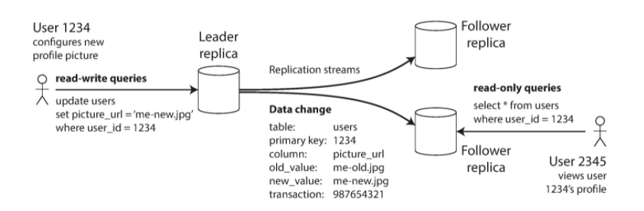
Leaders and Followers
Replica: each node that stores a copy of a database.
Problem: Given multiple replicas how can we ensure data ends on all replicas?
One possible solution: Leader-based replication (active/passive or master/slave replication).
Notes:
One of the replicas is designated the leader (also known as master or primary). When clients want to write to the database, they must send their requests to the leader, which first writes the new data to its local storage.
The other replicas are known as followers (read replicas, slaves, secondaries, or hot standbys). Whenever the leader writes new data to its local storage, it also sends the data change to all of its followers as part of a replication log or change stream. Each follower takes the log from the leader and updates its local copy of the database accordingly, by applying all writes in the same order as they were processed on the leader.
When a client wants to read from the database, it can query either the leader or any of the followers. However, writes are only accepted on the leader (the followers are read-only from the client’s point of view).

Slide 14
Synchronous vs Asynchronous Replication
Synchronous databases ensure leaders are forced to wait until followers are complete before continuing processing writes.
Advantage:
Followers guaranteed up-to-date copy of data.
Disadvantage:
Synchronous followers not responding, writes cannot be processed by leader.
Asynchronous databases allow the leader to proceed processing queries without confirmation from followers.
Advantage:
No waiting for leader for followers to complete replication.
Disadvantage:
If the leader fails, there is no guarantee of a node with the most up-to-date copy of data.

Slide 15
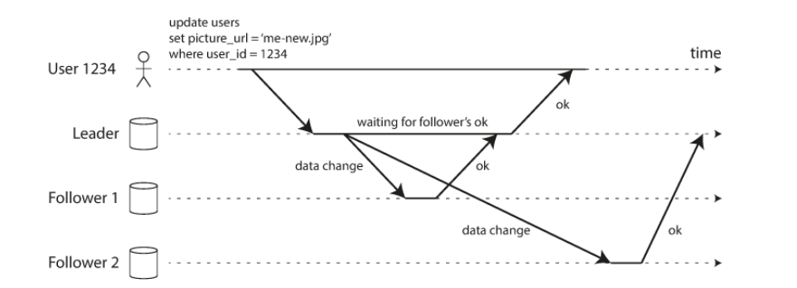
Semi-synchronous Replication
Usually if a database enables synchronous replication, it means a single follower is synchronous, while others are asynchronous.
If the synchronous follower becomes unavailable or slow, one of the asynchronous followers are made synchronous.
Overall, this is also referred to as semi-synchronous.

Slide 16

Setting Up New Followers
Copying data from one node to another is
insufficient.
Data is always in flux, standard copies would
read different parts of the database at different
points in time.
It can be done as follows:
Take consistent snapshots of leader database at some point in time.
Copy snapshot to follower node.
Follower connects to leader and requests all data changes since snapshot.
When follower processes backlog, it is said to caught up.
Notes:
1) Third party tools can be used to take snapshot (innobackupex MySQL).
3) Snapshot is associated with exact position in time in leader's replication log. MySQL calls this binlog coordinates.
4) After this step the follower can continue to process changes from the leader as they happen.

Slide 17
Handling Node Outages
Any node can fail at any time. Goal is to keep system running despite nodes failing and make impact as small as possible.
Follower Failure (Catch-up recovery):
Follower local disk keeps a log of data changes from leaders. If the follower node fails, they can recover by querying the leader of subsequent changes.
Leader Failure (Failover):
One follower needs to be promoted as the new leader, clients need to reconfigure to send writes to new leader, and other followers need to start consuming changes from the new leader.
Usually done manually but an automatic process has the following steps:
Determine if leader has failed: If a node does not respond for some period, it is assumed dead (say 30 seconds).
Choosing a new leader: election process (where remaining replicas decide through majority vote). Or a new leader is appointed by an election controller. Best candidates usually have the most up-to-date data changes.
Reconfiguring the system: clients now send their write requests to the new leader (request routing). If the old leader comes back, it may still believe it is the leader. System must ensure old leader becomes a follower.

Slide 18
Problems with failover
Asynchronous replication: new leaders may not receive all writes from old leader. Old leader may have conflicting writes if it rejoins so usually this data is discarded.
Discarding writes can be dangerous if the system encodes important shared information (already using some primary keys).
Multi-Leader replication: Sometimes two nodes think they are the leader, and both accept writes. Data can be lost or corrupted.
Determining the right timeout size.

Slide 19
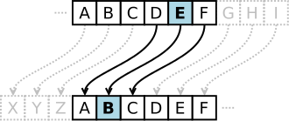
Countermeasures - Computer Based Controls
Encryption:
The encoding of data by a special algorithm that renders the data unreadable by any program without the decryption key,
Caesar cipher: One of the easiest and most famous example of encryption.
Take the alphabet and shift the offset of each letter up by some set amount.
While encrypting the message use this alphabet shift to replace each letter in the message.
A colleague can decipher the message with a known shift of letters.

Slide 20
Countermeasures - Computer Based Controls
RAID (Redundant Array of Independent Disks):
Hardware for DBMS’s should be fault-tolerant (the DBMS should continue to operate even if one of the hardware components fail).
Redundant components can be added into a working system to withstand one or more component failures.
Main components to be considered for this are:
Disk drives
Disk controllers
CPU
Power supplies
Cooling fans
Disk drives are the most vulnerable components, with shortest times between failure (mean failure time 10-50 years).

Slide 21
RAID (Redundant Array of Independent Disks):
Solutions to disk failure include RAID technology.
A large disk array comprising an arrangement of several independent disks organized to improve reliability and increase performance.
Performance increase happens with striping because several I/O commands can be serviced at any one time.
Reliability is improved by storing redundant information across the disks using a parity scheme or error-correcting scheme.
Parity scheme: each byte has a parity bit associated with it that records whether the number of bits in the byte that are set to 1 is odd or even. If a single bit is corrupted the parity will not match.
An error-correcting scheme can be used to fix the corrupted bit.

Slide 22
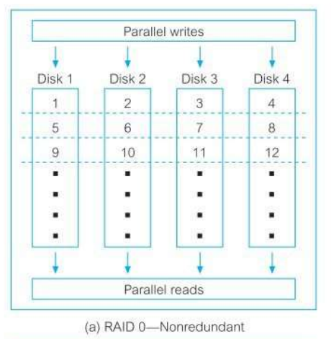
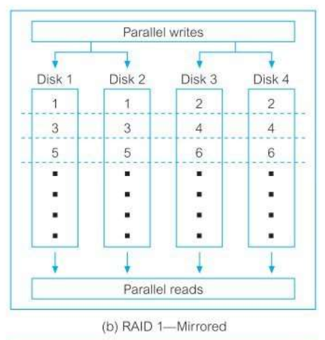
RAID (Redundant Array of Independent Disks) levels of RAID configurations:
RAID 0: Nonredundant:
Uses no redundant data and has best write performance.
Data striping is performed at level of blocks.
RAID 1: Mirrored:
Two identical copies of data across different disks.
Maintains consistency during disk failure, writes may not be simultaneous.
Notes:
There are several more configurations. In the textbook 6 are listed.

Slide 23
DBMSs and Web Security
Internet communication often relies on TCP/IP and HTTP as the underlying protocol.
These were not designed with security in mind (people can often view packets sent over a network freely using packet sniffing software).
While transmitting and receiving information over the internet it should be ensure that:
It is inaccessible to anyone but the sender and receiver (privacy).
It has not changed during transmission (integrity).
The receiver is sure it came from the sender (authenticity).
The sender is sure the receiver is genuine (non-fabrication).
Sender cannot deny they sent it (nonrepudiation).

Slide 24
DBMSs and Web Security - Measures
Proxy Server:
Sits between web browser and server
Improves performance by serving requests on proxy if information still in cache.
Filters requests such that selected websites cannot be used.
Digital Certificates:
An attachment to an electronic message used for security purposes. It verifies that a user sending a message is who they say they are.
It also provides the receiver the key to encode a reply.
An individual wishing to send an encoded message applied to a certificate authority- CA (verisign/geoTrust etc).
The CA provides an encrypted digital certificate containing the applicant's public key.
The CA vouches for the authenticity of the sender and receiver and provides keys for them to exchange messages securely.
Firewalls:
Prevents unauthorized access to or from a private network.
It examines messages entering or leaving a network and blocks those that do not meet specified security criteria.
Notes:
There are many others used like:
Kerberos
Secure sockets layer and secure HTTP
Secure electronic transactions and transaction technology

Slide 25

Reliability Case Study –Netflix Simian Army
No single component can guarantee 100% uptime so Netflix designed a cloud architecture where individual components can fail without affecting the entire system.
Chaos Monkey: A tool to randomly disable production instances to ensure they can survive this common failure.
Running this program in the middle of the day in a busy environment with standby engineers they can learn lessons about weaknesses in the system, so failures during down-time are less noticeable.
Other examples include Latency, Conformity, and Doctor Monkey.

Slide 26
Countermeasures – Non-Computer-Based-Controls
Concerned with matters such as policies, agreements, and other administrative controls. These include:
Security policy and contingency plan
Personnel control
Securing positioning of equipment
Escrow agreements
Maintenance agreements
Physical access control

Slide 27
Countermeasures – Non-Computer-Based-Controls
Security policy and contingency plan:
Security policy addresses how an organization is to maintain a secure system:
Agreed encryption methods
Digital certificates
Authentication/authorization
All the stuff already discussed
Contingency plan addresses how an organization will react and continue to operate in an emergency situation.
Both are required

Slide 28
Countermeasures – Non-Computer-Based-Controls
Security policy should address:
Area of business it covers
Responsibility and obligations of employees
Disciplinary action in case of breaches
Procedures to be followed
Contingency plan should address:
Establish response necessary to deal with unusual events
Plan should include:
Key personnel and how to contact
Who decides contingency exists
Technical requirement of transferring operations to another site
Operational requirement of transferring operations to another site
Important external contacts
Whether insurance exists to cover situation
Should be periodically reviewed

Slide 29
Countermeasures – Non-Computer-Based-Controls
Legal Personnel Controls
Threats often involve internal staff
Adequate control mechanisms are required to minimize the risk of all staff accessing protected data.
Securing Positioning and Storage:
Using locked rooms
Restricted access to hardware
Alarms
Secure storage area for backups/documentation

Slide 30
Countermeasures – Non-Computer-Based-Controls
Escrow agreements:
Legal contracts concerning software between developers and clients.
Third party holds source code for client application.
Client can acquire source code if developer goes out of business (ensures client can still maintain systems).

Slide 31
Main stages of Risk Analysis
Establish a security team.
Define scope of analysis and obtain system details.
Identify existing countermeasures.
Identify and evaluate all system assets.
Identify and assess all threats and risks.
Select countermeasures, undertake a cost/benefit analysis, compare with existing countermeasures.
Make recommendations.
Test security systems.

Slide 32
Data Protection and Privacy Laws
Privacy: right of an individual not to have personal information collected, stored, and disclosed either wilfully or indiscriminately.
Data protection: protection of personal data from unlawful acquisition, storage, and disclosure, and provision of the safeguards to avoid the destruction or corruption of legitimate data.
Privacy Law: concerns personal data rights of individuals with respect to personal data.
Legislation attempts to protect individuals from abuse, and enable organisation to carry out lawful activities/duties.

Slide 33


Data Protection and Privacy Laws
Important legal acts relating to data protection include:
EU data protection directive
US Patriot Act
General Data Protection Regulations (GDPR)

Slide 34
Data Protection and Privacy Laws
EU Data Protection Directive:
Protection of individuals with regard to processing of personal data and on free movement of such data.
Enacted in 1995
EU privacy and human rights law
Seven principles governing the protection of personal data:
Notice: data subjects should be given notice when data is being collected.
Purpose: data should be used for stated purpose and nothing else.
Consent
Security: should be kept secure from potential abuse.
Disclosure: data subjects should be informed who is collecting their data.
Access: data subjects should be allowed access to their data.
Accountability: subject should be able to hold collectors accountable for breach of above.

Slide 35
Data Protection and Privacy Laws
General Data Protection Regulations (GDPR) :
Introduced in EU May 2018
Superseded EU data protection Directive
Applies to enterprises/individuals
Contains provisions and requirements related to processing of personal data
Prohibitive penalties for breaches
Seven Data Privacy Principles:
Lawful, fair, and transparent
Purpose limitation
Data Minimisation
Accuracy
Storage Limitation
Integrity and Confidentiality
Accountability

Slide 36
Data Protection and Privacy Laws
US Patriot Act:
Enacted in October 2001 following 9/11 attacks
Aimed at protection from challenges posed by global terrorist networks.
Brought the law up to data with current technology:
E911 calls
Mobile tracking and wire-tapping
Circumstantial evidence
Inter-agency cooperation to tackle terrorism

Slide 37
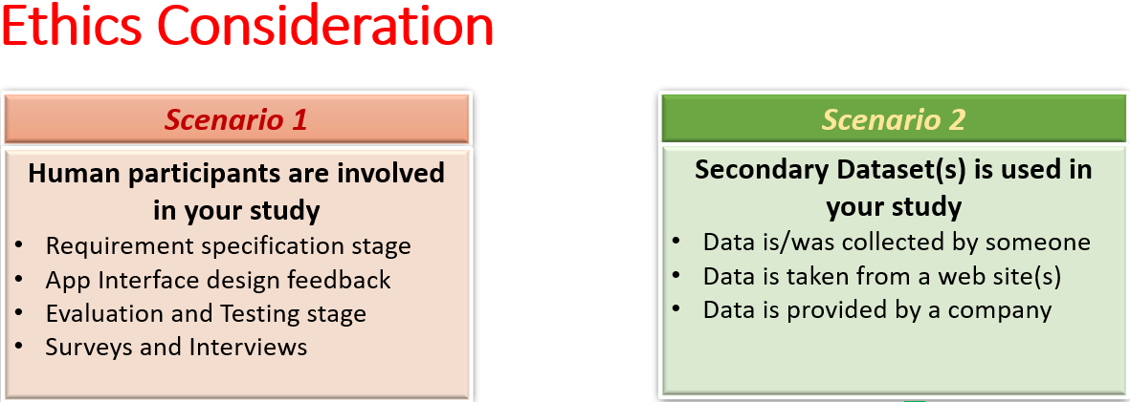
Data Protection and Privacy Laws
Ethics in Research NCI

Slide 38
Summary
Database security
Threats
Computer-Based Countermeasures
Non-computer-based countermeasures
Risk Analysis
Data Protection

